Slide 1
Product Sales Analysis
$
Pens and Printers Company
€
01

Slide 2
Table of contents
DESCRIPTIVE STUDY
DATABASE CLEANING
UNIVARIATE AND BIVARIATE ANALYSES
DEFINITIONS AND MONITORING OF INDICATORS
SUMMARY AND RECOMMANDATIONS
01
02
03
04
05
02

Slide 3
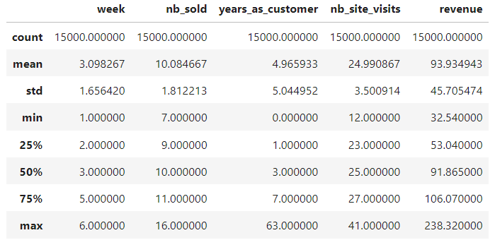
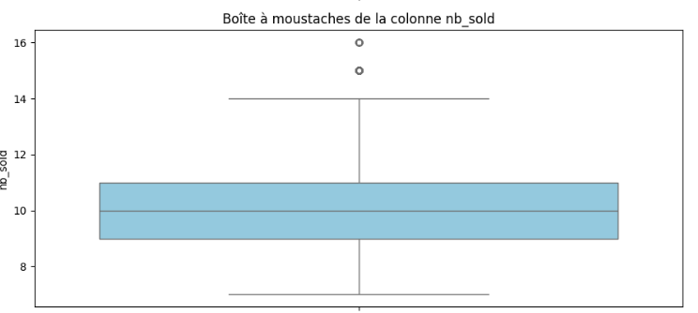
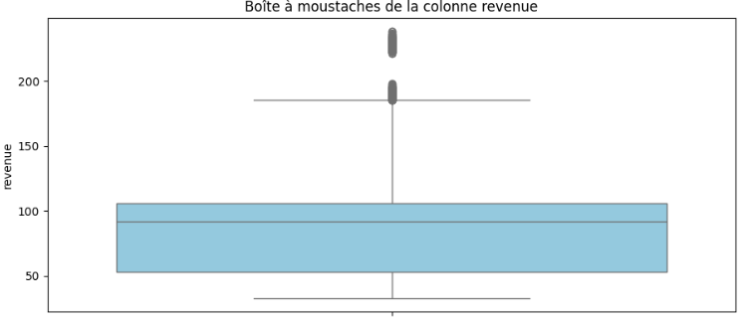
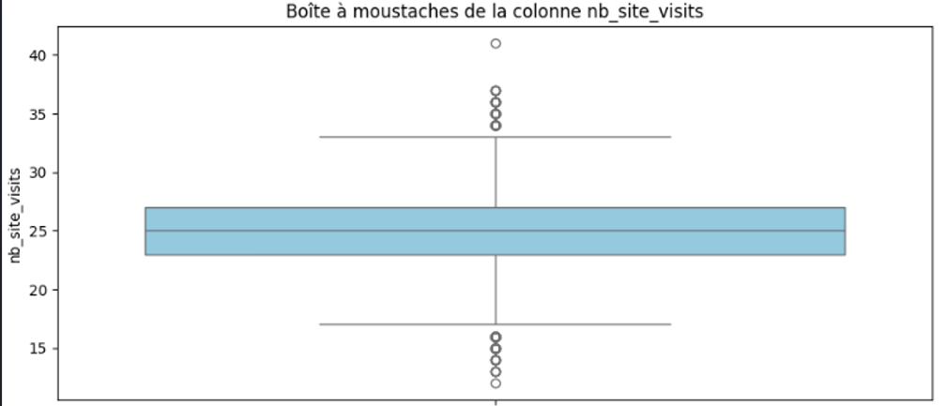
Descriptive Study
Descriptive statistics for each database column
Whisker of ‘nb_sold’ column
Whisker of ‘revenue’ column
Whisker of ‘nb_site_visits’ column
03

Slide 4
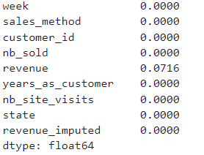
Database Cleaning
Number of missing values for each column
*Given that missing values depend on the column itself, we've used the IterativeImputer method, which is a regression-based method, to deal with this.
Validation and cleaning for each column
*We made sure there were no anomalies in the values of each column and cleaned them up. Eg. : change 'em + call' to 'Email + Call' in the 'sales_method' column
04

Slide 5
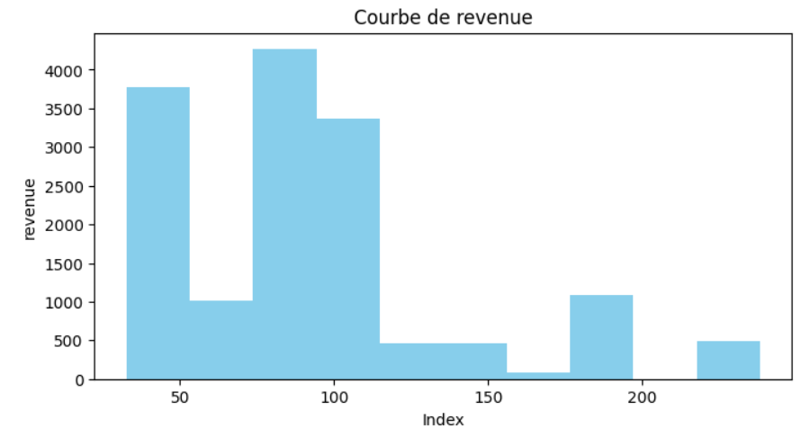
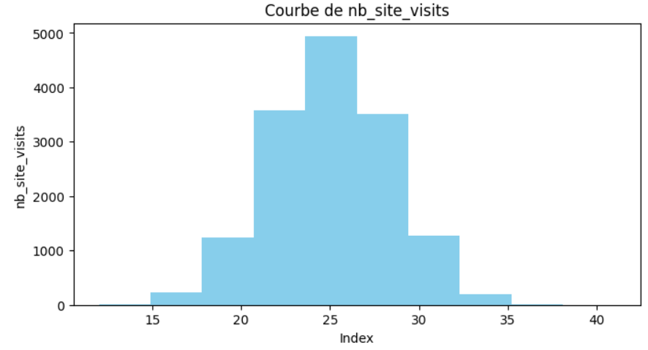
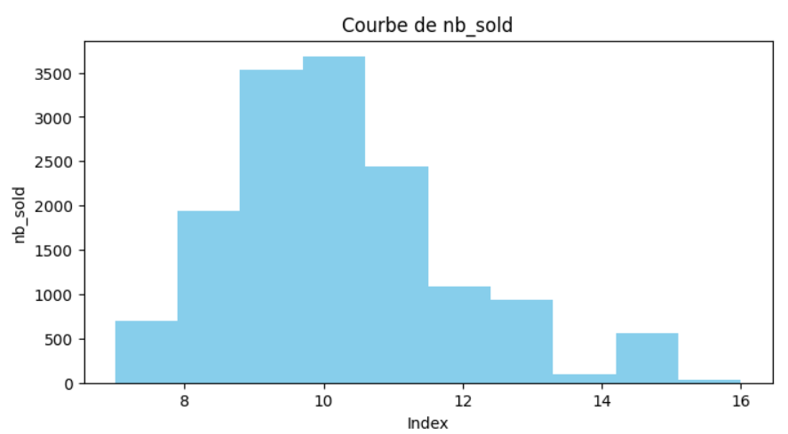
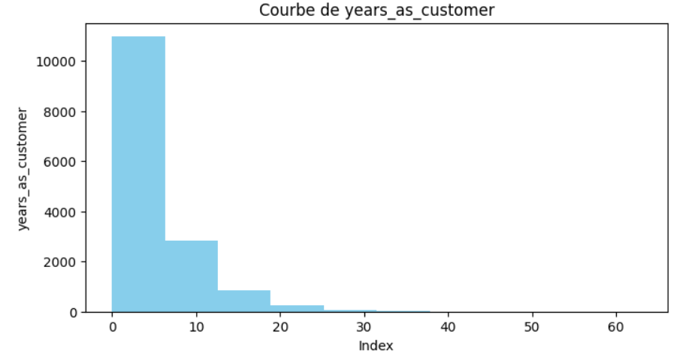
Univariate and bivariate analyses
distribution of the 'revenue' column
distribution of the ‘nb_site_visits' column
05
distribution of the ‘nb_sold' column
distribution of the ‘years_as_customer' column

Slide 6
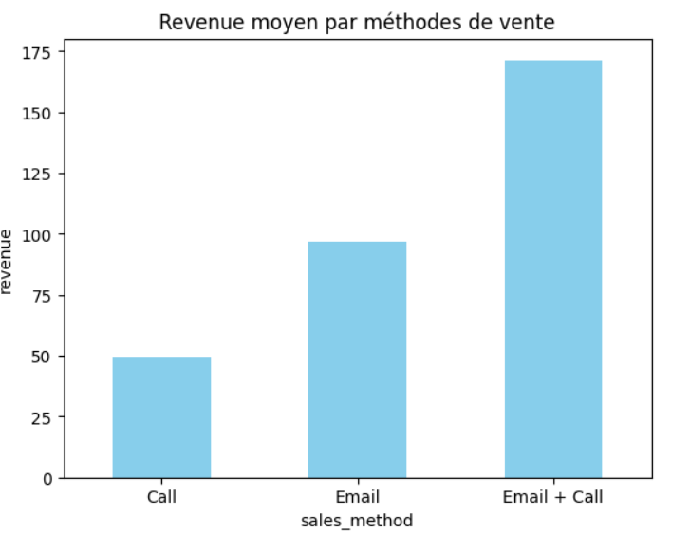
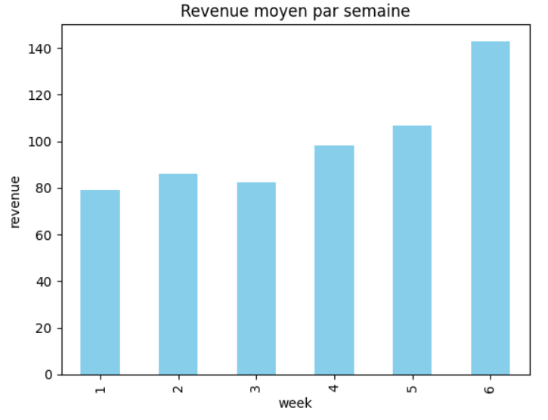
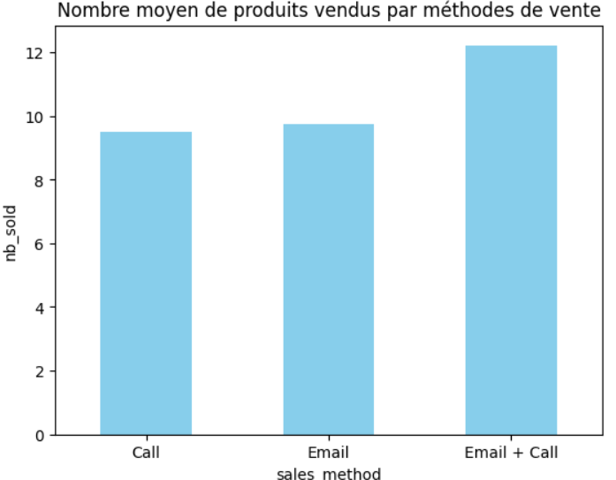
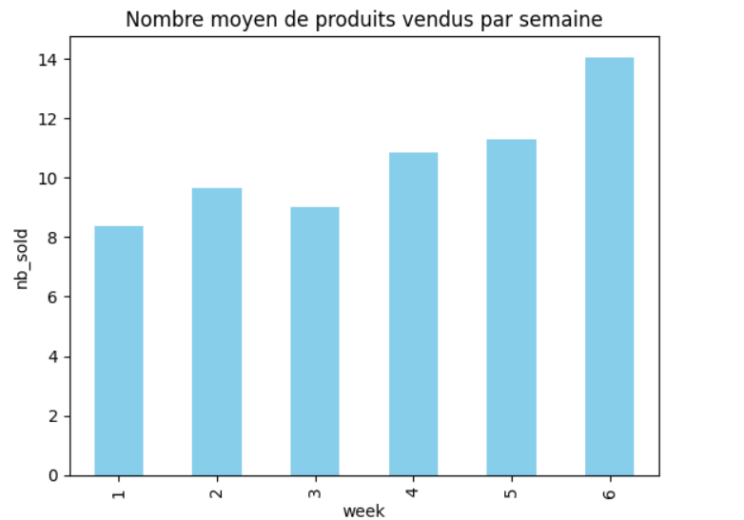
average revenue by sales method
average revenue by week
‘nb_sold’ distribution by sales method
‘nb_sold’ distribution by week
06

Slide 7
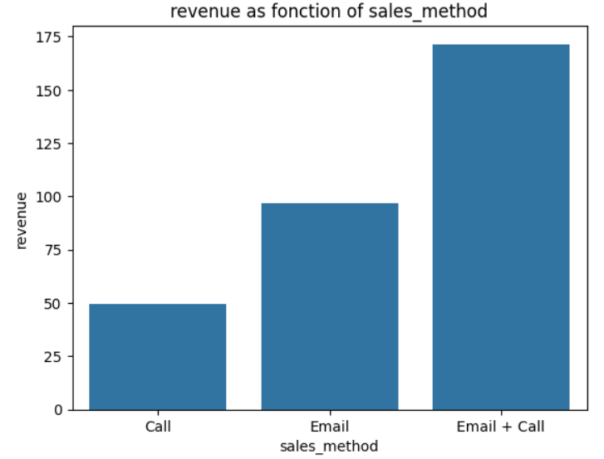
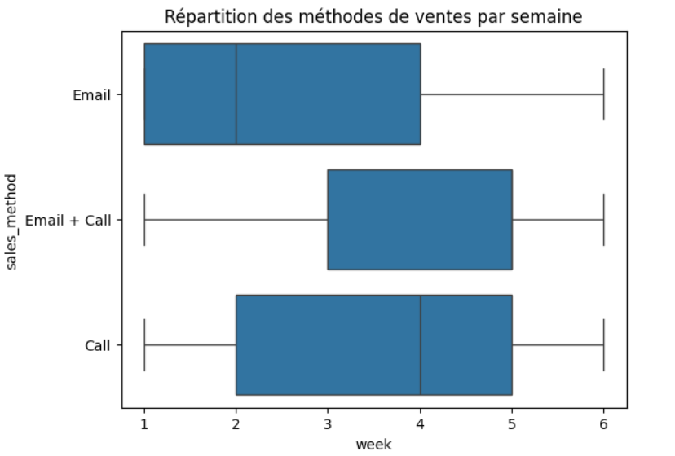
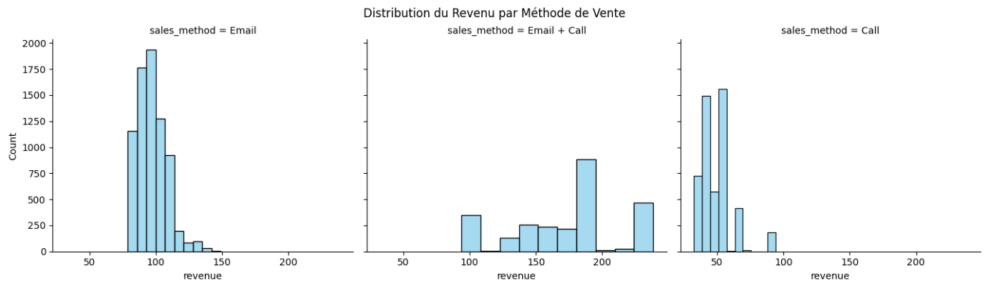
‘revenue’ distribution by sales method
‘sales_method’ boxplot by sales method
distribution of the ‘revenue’ column by sales method
After analyzing all these charts, we can see that the best sales method is 'Email + Call'.
07

Slide 8
Definition and monitoring of the indicators
Proposed indicator: Average revenue per customer by sales method
Tracking the average revenue per customer for each sales method will enable the company to :
Identify which approaches generate the most revenue.
Determine whether certain methods are more effective over the long term.
Adjust its strategies to focus efforts on the best-performing approaches.
08

Slide 9
Definition and monitoring of the indicators
To monitor what the company wants to achieve, we can follow these steps:
- Regularly calculate average revenue per sales method: This calculation should be made after each sales period (e.g. monthly or quarterly).
- Compare the evolution of average income: Monitoring changes over time will help you see whether a sales method is becoming more or less successful.
- Track revenue dispersion (standard deviation): It can be useful to look at the variance in revenue generated per customer for each method.
- Analyze other factors: For example, the number of years the customer has been with the company or the number of visits to the site
09

Slide 10
Summary
In summary :
we analyzed data relating to the launch of Pens and Printers' new product range ;
We analysed each variable and the relationships that might exist between them ;
As a result, we found that the most profitable sales method was the combination of calls and emails ('Email + Call’).
Recommandations :
Calculate the average revenue per sales method ;
Compare the evolution of average revenue ;
monitor revenue dispersion (standard deviation) ;
Analyze other factors that could impact revenue.
10

